Slide 1

Lighting Tools Analysis
By Kinjal Majumdar

Slide 2
Assumptions
The measurement unit for the hook ‘Duration’ is unknown so this field will not be used for time based analysis.
When referring to Lighting Tools they are the broader set of events that are triggered when the sourceView field has the term ‘light’ mentioned in it. Lighting Tools comprise of Unity Editor Lighting Window as well as other Lighting Tools.
Further exploration and validation is required in order to determine whether there are valid hooks that indicate ‘errors’ within the date. For the time being we have assumed that data pertaining to errors is not available.
Missing values for certain fields have not been treated, as imputing them for the fields used in calculation was not always appropriate. In other words we can proceed with them as nulls and not have it significantly impact the data.

Slide 3
Contents
How many Creators are using our Lighting tools?
What user insights do we have on them?
How much time do they generally spend on our Lighting tools?
Are they satisfied with our current offerings?
Do Creators experience any errors when using our Lighting tools?
How many Creators use “bakeBackend”?
Which version of “bakeBackend” is used the most?
How many Creators use the Menu button in the Unity Editor to find our Lighting tools?
What is the preferred Lightmap size?
Highlighted questions to be looked at in further analysis

Slide 4
How many Creators are using our Lighting tools?
794
users use Lighting Window from Unity Editor
800
users use Lighting Tools

Slide 5
How many Creators are using our Lighting tools?
91.3%
of all users use the Unity Editor
99%
of users who use Lighting Tools use the Unity Editor

Slide 6
What user insights do we have on them?
1.5
Average number of sessions per user
1.2
Average number of sessions per users who use Lighting Tools

Slide 7
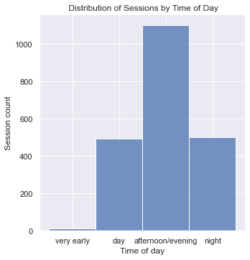
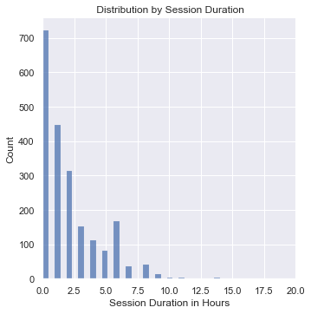
What user insights do we have on them?

Slide 8
What user insights do we have on them?
The majority of Lighting Tool users use Unity on Windows
The majority of Lighting Tool users engage during the afternoon or evening.
The majority of Lighting tool users register sessions that range between
0 to 10 Hours

Slide 9
How much time do they generally spend on our Lighting tools?
6.5 Hours
average total time spent on
Lighting Tools
2.5 Hours
average time per session spent by users who use Lighting Tools

Slide 10
How many Creators use “bakeBackend”? Which version of bakeBackend was used most?
15,607
creators use bakeBackend
69%
of them used ProgressiveCPU
21%
of all users use bakeBackend

Slide 11
What is the preferred Lightmap size?
1,024
Preferred Lightmap size

Slide 12
Thank You

